Slide 1


Deadline-aware Transport Protocol
Hang Shi¹, Yong Cui¹, Feng Qian², Yuming Hu¹
¹Tsinghua University, ²University of Minnesota – Twin cities

Slide 2

Internet is becoming real time
More and more applications has deadline requirement for its multiple concurrent block transmission.
Application
Deadline
Push/pull
Block
Priority
Video conferencing
100
ms
Push
Frame
audio > video
, I Frame > P frame
Online gaming
60
ms
sync
Push
Command message
killing > moving
Cloud VR gaming
25
ms
Pull
Foreground object,
foreground > background
background scene
360 degree
video
Varying
Pull
Tiles
central >
around
Notes:
As we all know, the internet is becoming real time. More and more emerging applications is interactive and has deadline requirement for its transmission. Such cloud VR gaming and 360 degree video(click). The cloud VR game has strict motion-to-photon latency(25 ms) to avoid motion sickness. Many traditional applications such as video, conferencing and online gaming has deadline requirement too. (click)The deadline of those applications can be divided into 2 categories. It depends on the transmission mode of the application. If the application is push based, the deadline is one way time. If the application is pull based such as HTTP, the deadline is the round trip time. (click)All those applications are transferring in block fashion such as frame in video conferencing and tiles in 360 degree video. The block is also the minimal processing unit. So the deadline is the block completion time. (click)Those applications usually generate and transfers multiple block concurrently. Different blocks have different importance to the user experience. The example is shown in the table. Such as in 360 degree video, the tile in the central area of the viewport is more important than surrounding tiles.

Slide 3
New apps -> new requirements
Multiple concurrent blocks with varying priorities
Deliver before deadline
Dynamically adjust the deadline and priority

Slide 4
Case 1: 360 degree video streaming
Tile based solution.
Fetch tiles based on user’s viewport
Deadline: playback time – local processing time
Predict the head movement to prefetch

Slide 5
Case 2: Cloud VR gaming
Foreground object and background scenes.
Prefetch background panoramic scenes based on character’s movement in virtual world.
Deadline:
Background scenes: character arriving time – local rendering time
Foreground object: user interactive time – rendering time

Slide 6
Case 3: Cooperative augmented vehicular reality
Extend the vision by sharing views between vehicles to improve security
Different objects in the view has different priorities and deadline
Deadline: object distance / movement speed
Relative position may change.

Slide 7
Existing transport layer lacks support
Apps are forced to build their own wheels(Salsify⁶ NSDI18, Redundant Data Bundling in games): Complex.
We need a transport protocol to provide deliver-before-deadline service
Notes:
However, all existing transport layer lacks support for the transmission requirement as is shown in the table. Without the support from the transport layer, those applications are forced to build their own wheels. They design highly customized solution in cross layer fashion such as Salsify for video streaming. Those efforts are complex and redundant. If we can build a transport protocol providing such a service. Application developer can be free from the burden and focus on their business logic.

Slide 8
Solution space
Match sending rate with network capacity
Modify switch, router(DetNet¹, TSN²):
Need to upgrade all routers.
Synchronize all sender, do not send at the same time(NSDI 15 QJump³):
Infeasible in WAN
End to end transport protocol:
Lifetime option in SCTP, drop after lifetime
Timelined-TCP⁴(IFIP 02): not compatible with TCP
TCP Hollywood⁵(IFIP 16): use SOBS encoding to be wire compatible with TCP.
Notes:
The key to provide the deliver before deadline transmission service is to match the sending rate with the network capacity. There are three types of solution to accomplish that.
The first is to do resource reservation and allocation on the switch such as TSN(time sensitive network). But this approach requires upgrading all routers.
The second approach is to synchronize all sender(Like the QJump), do not send at the same time so the network will not get congested. Obviously this is not feasible in the wide area network.
The most practical approach is working on end to end transport protocol. Many researchers have propose the deadline concepts in various protocols such as SCTP and TCP.
reference

Slide 9
Their problems
Deployment:
SCTP is restricted by middlebox.
TCP is ossified. Hard to extend: Kernel change and middlebox.
No optimization for deadline, just drop stale data after it misses its deadline.
No support for pull based transmission. How to build HTTP layer on top of deadline transport protocol?
Notes:
However, those proposal has their problems and never get traction.
First, they suffer from deployment issue. SCTP is blocked by some middleboxes. TCP is hard to extend because it is in the kernel and adding option can be blocked by middebox.
Second, they do not do anything to optimize the deadline delivery. They just drop the stale data. We can do better
Third, they do not handle the pull based transmission. Many applications have deadline requirements are using HTTP like protocol.

Slide 10
Our solution: DTP(Deadline-aware Transport Protocol)
Built on top of QUIC. Easy deployment
Allocate resource to more important stream
drop low priority stream
redundancy for tail packets to avoid retransmission delay
Support both push and pull based transmission.
Notes:
Our protocol is built on top of QUIC for easy deployment. To optimize for deadline delivery, our protocol will drop low priority stream to save bandwidth for high priority stream. We also use redundancy to avoid retransmission delay when necessary. We build both the transport layer and HTTP layer.

Slide 11
Abstraction and API
Block instead of stream: Video frame, file chunk, html objects.
Application marks the block with deadline and priority.
Deadline: block completion time. E.g, this frame is supposed to deliver within 100ms.
Application can query the delivery result(how many data are delivered before deadline) to do rate adaptation.
Notes:
Our transport layer API is block based instead of stream. Each block has its own ID and metadata such as deadline and priority. The deadline means the block completion time. Since our protocol optimized for deadline delivery instead of reliability, some blocks may get dropped. Application can query the delivery result to do rate adaptation. If it finds some low priority data always get dropped, it can stop generate the low priority data to save the computation power.

Slide 12
Architecture
Dedicated buffer and retransmission queue for each block
Scheduler pick which block to send based on deadline, priority and network conditions
Apply redundancy for tail packets to avoid retransmission delay when necessary
App level
Transport level
Data flow
Control flow
0
…
Sender
Redund-ancy
Encoder
CC
RTX
Sched
1
…
2
RTX
…
…
......
…
…
buffer
RTX
Lost packet
BD, RTT
Loss rate
Notes:
The architecture of the sending side of our transport protocol is shown in the figure. DTP will maintain dedicated buffer and retransmission queue for each block.
Then the scheduler will pick which block to send. When the bandwidth is not enough, scheduler will drop the low priority block. After that the redundancy module will apply redundancy for tail packets to avoid retransmission delay when necessary.

Slide 13
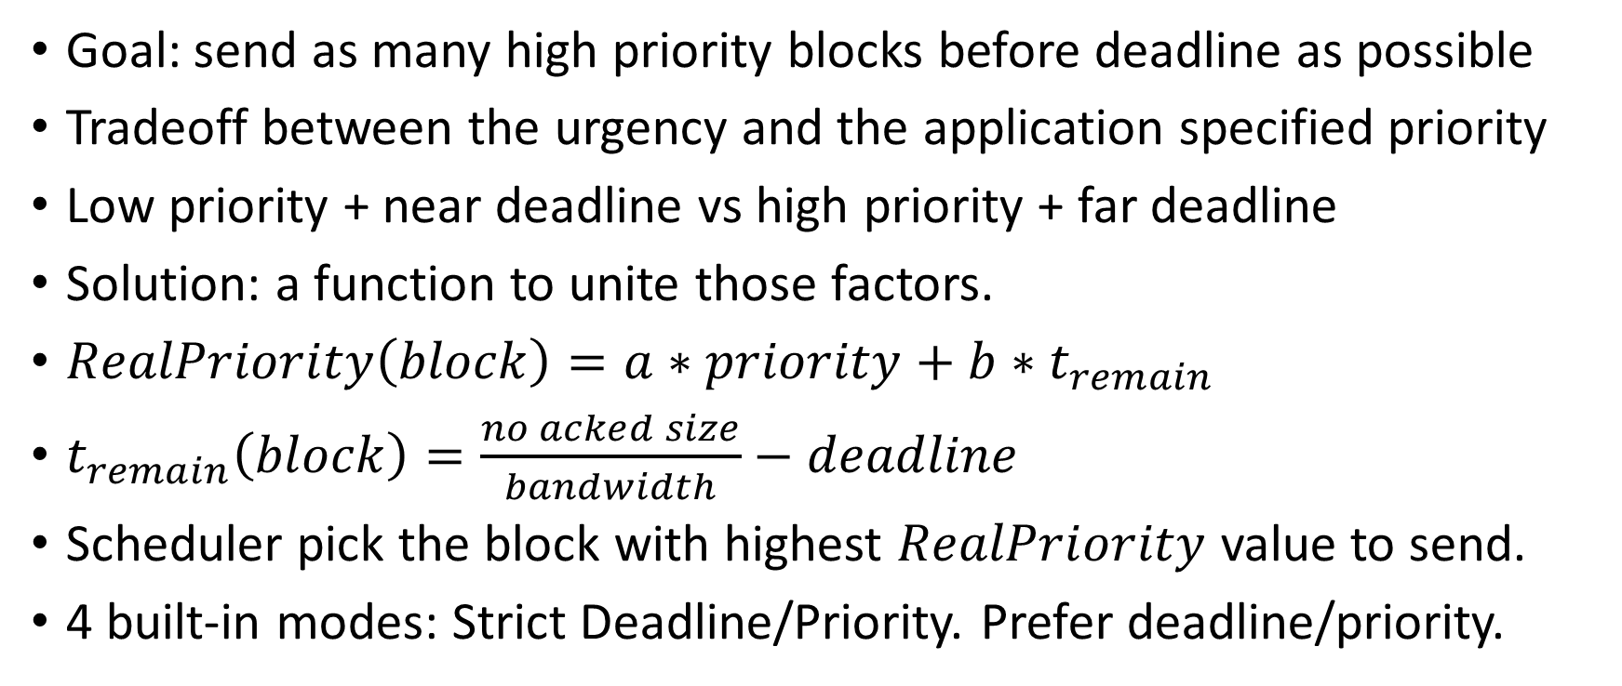
Deadline aware scheduler
Goal: send as many high priority blocks before deadline as possible
Tradeoff between the urgency and the application specified priority
Low priority + near deadline vs high priority + far deadline
Solution: a function to unite those factors.
$RealPriority\left(block\right)=a∗priority+b∗t_{remain}$
$t_{remain}\left(block\right)=\frac{no acked size}{bandwidth}−deadline$
Scheduler pick the block with highest $RealPriority$ value to send.
4 built-in modes: Strict Deadline/Priority. Prefer deadline/priority.
Notes:
Let’s first dive into our deadline aware scheduler. The goal of the scheduler is to send as many…. The challenge of the scheduler lies in the tradeoff between the urgency… Image there are two blocks, one is low priority but is about to miss the deadline. The other has high priority but the deadline is very far. Which block to send? Sending one block may cause the other missing deadline. We need a function to resolve the conflict between application specified priority and the deadline implied priority. We can calculate the real priority of the block using this function. Remaining time is estimated using this function. Then scheduler pick the block with highest real priority value. Our protocol provide 4 different modes of this function. Application can customize it if they want.

Slide 14
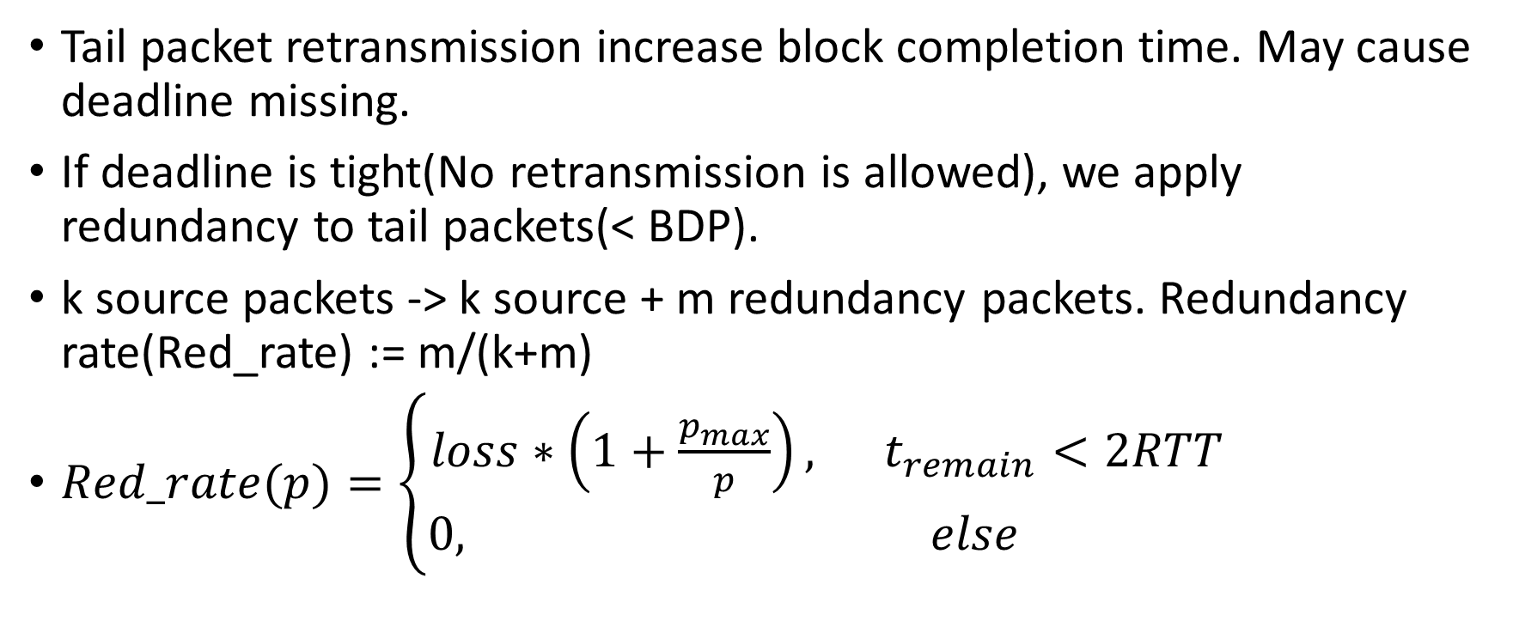
Adaptive tail FEC
Tail packet retransmission increase block completion time. May cause deadline missing.
If deadline is tight(No retransmission is allowed), we apply redundancy to tail packets(< BDP).
k source packets -> k source + m redundancy packets. Redundancy rate(Red_rate) := m/(k+m)
$Red\text{_}rate(p)=\left\{\begin{aligned}loss∗\left(1+\frac{p_{max}}{p}\right), t_{remain}<2RTT \\ 0, else \end{aligned}\right.$
Notes:
We also use FEC to deal with lossy environment. We all know the tail packet retransmission will increase the block completion time. So our adaptive FEC is only applied for tail packets. And only if the deadline is too tight for retransmission. We use following functions to calculate the redundancy rate for each priority, basically, the redundant rate need to cover for the loss rate and the higher priority block has higher redundancy.

Slide 15
Extension to QUIC and HTTP/3
Reuse handshake, encryption, stream management, congestion control, flow control
1 block = 1 HTTP3 stream = 1 QUIC stream(light weight)
Add deadline and timestamp to STREAM frame
When block is dropped by sender or receiver, close the stream and notify the other end by sending RESET_STREAM
When QUIC stream is closed, notify HTTP 3 layer. HTTP 3 layer send HTTP CANCEL or HTTP REJECT to notify the other end.
HTTP GET carry deadline and priority, server response call send with those metadatas.
Notes:
To implement the protocol, we make server extension to QUIC and HTTP 3 stack. We reuse most ….
And add deadline, timestamp to stream frame.
We implement the block abstraction on top of QUIC stream. 1 block is mapping to 1 QUIC stream and 1 HTTP 3 stream.

Slide 16
Apps implementation and evaluation plan
360 degree video(Pull)
Deadline = playback time
Priority based on how many pixels the tile is inside the viewport.
Improve stall time and video quality
Mobile VR offloading(Pull)
Deadline = movement time
Priority based on movement trajectory
Improve latency
Online PvP games(Push)
Deadline = server sync time
Priority based on command type
Improve command execution rate
Notes:
We plans to use following applications

Slide 17
Summary
Deadline-aware transport protocol based on QUIC
Deadline aware scheduler and adaptive tail redundancy to improve deadline delivery
Provide both HTTP and transport layer API

Slide 18
Reference
Detnet, Deterministic Networking, https://datatracker.ietf.org/wg/detnet
TSN, Time sensitive networking, https://1.ieee802.org/tsn/
Grosvenor, Matthew P., et al. "Queues Don’t Matter When You Can {JUMP} Them!." 12th {USENIX} Symposium on Networked Systems Design and Implementation ({NSDI} 15). 2015.
Mukherjee, Biswaroop, and Tim Brecht. "Time-lined TCP for the TCP-friendly delivery of streaming media." Proceedings 2000 International Conference on Network Protocols. IEEE, 2000.
McQuistin, Stephen, Colin Perkins, and Marwan Fayed. "TCP Hollywood: An unordered, time-lined, TCP for networked multimedia applications." 2016 IFIP Networking Conference (IFIP Networking) and Workshops. IEEE, 2016.
Fouladi, Sadjad, et al. "Salsify: low-latency network video through tighter integration between a video codec and a transport protocol." 15th {USENIX} Symposium on Networked Systems Design and Implementation ({NSDI} 18). 2018.

Slide 19
Problem: scheduler’s complexity
Rate adaptation will pick the tile quality based on deadline, bandwidth
Assuming a simple scheduler:
Sort tiles by deadline.
Deadline-guarantee job:
Simple scheduler in transport layer
Complex rate adaptation in app layer

Slide 20
Scheduler’s complexity cont’d
What happens when video stall?
Client need to request a new tile ASAP.
How to set the deadline and priority of this new tile to guarantee that the server will send it immediately?
Client does not know the real rank function(f) used by the server.
Complex f (involving buffer status) -> new API to jump the queue.
Simple f (= deadline * p) -> set the deadline = now is enough.

